Slide 1
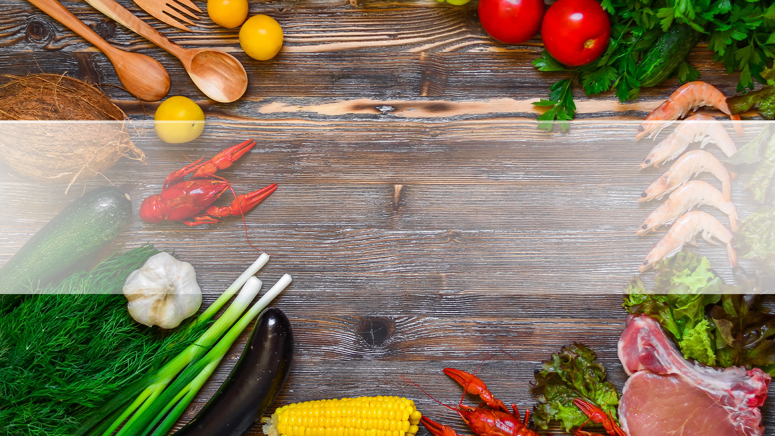
What’s Cooking?
Yummly Recipe Recommender System

Slide 2

What’s Cooking?
Aim:
Recommendation system to suggest similar recipes, similar ingredients and what ingredient goes best with what.
Why?
Create a comprehensive cooking assistant that helps you decide what to cook with the ingredients that you have.
Notes:
So the questions were – which recipes are similar, which ingredients are similar, how important is an ingredient in a recipe and what goes best with what?

Slide 3


Our Data
Yummly – 28K Recipes
BBC Food Website
Recipe Aggregator Site, API
From 60+ recipe sites/blogs
27637 Recipes (JSON Files)
Features:
Ingredients, Cuisine, Recipe Title, Ratings, Nutrition etc.
26 Webpages (A-Z) of Ingredient Names
1000+ Individual Food Ingredients
List of Related Ingredients
Common Dishes for Ingredient
Notes:
BBC Data – had Pizza as an ingredient! (Interesting)

Slide 4
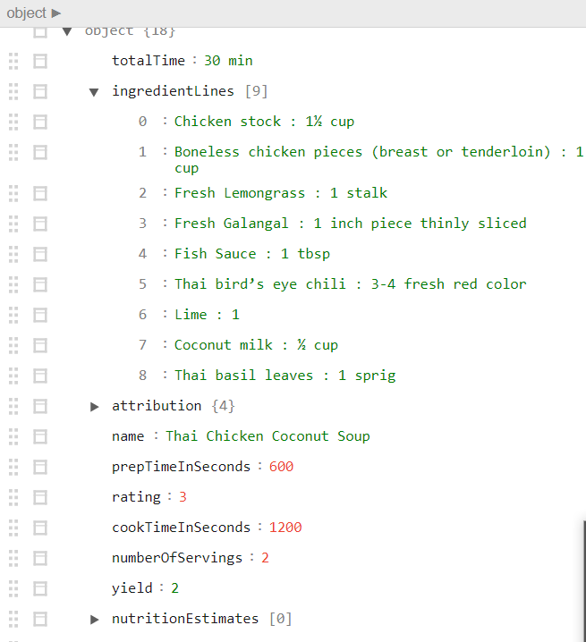
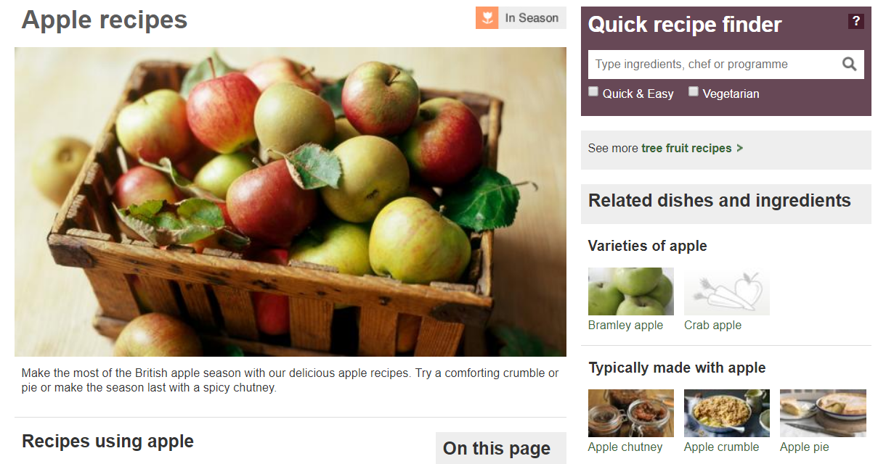
Data: Snapshot
Yummly Recipe - JSON
BBC Food Website

Slide 5
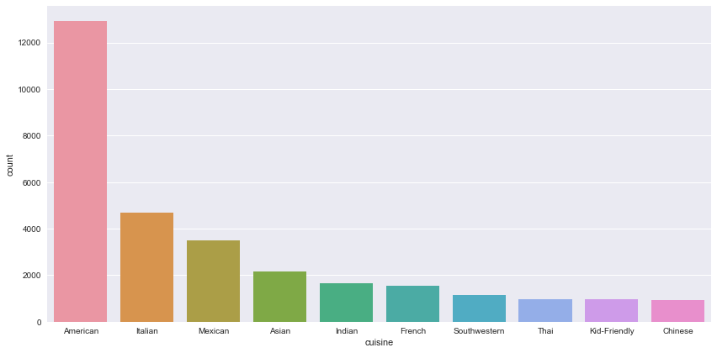
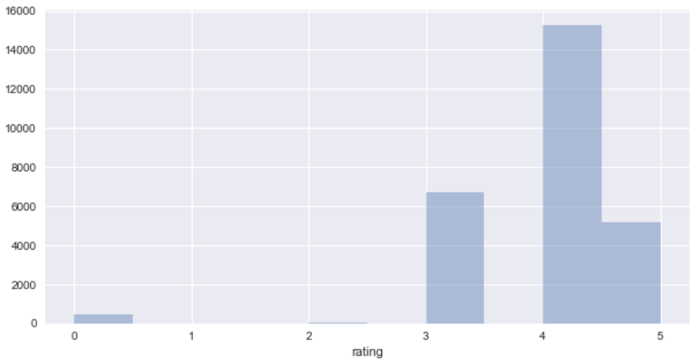
Quality of Data
Skewed Distribution across Cuisines
Skewed Ratings
Notes:
Duplicate Titles!
Hundreds of websites! - More than 60 blogs combines in Yummly
Ratings skewed to 4-5
Skewed cuisines

Slide 6
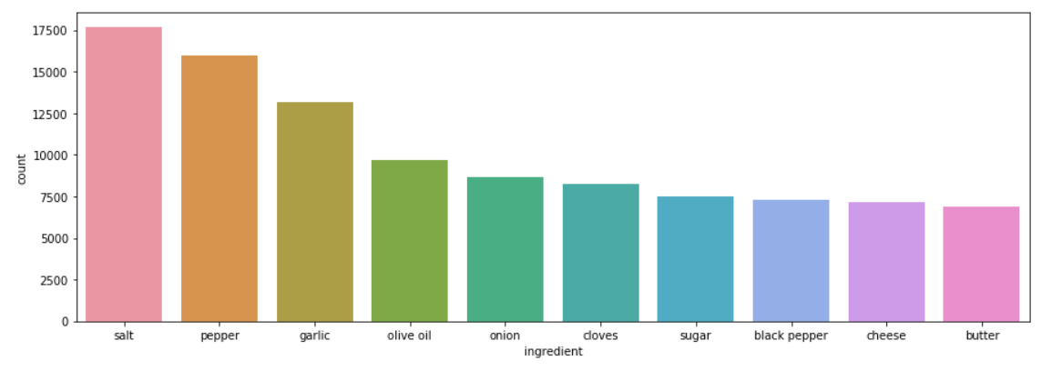
Quality of Data
Distribution of Ingredients across Recipes
Notes:
Duplicate Titles!
Hundreds of websites! - More than 60 blogs combines in Yummly
Ratings skewed to 4-5
Skewed cuisines

Slide 7


Our Process and Approach
'2 cups arborio rice' --> 'arborio rice'
28K JSON files
1 combined recipe file
Bigrams, Stem, Tokenization
Clean ingredients
'tomatillo', 'salsa'
Scraped
Related Ingredients
Clean recipe names
Add plural words
Scraped Ingredient list
'tomato'
'tomatoes'
Notes:
Prepocessing steps
Stemming tokenization bi grams

Slide 8
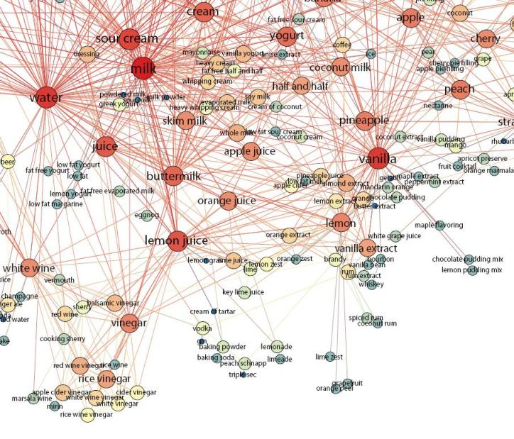
Related Work
Kissing Cuisines (Sajadmanesh et. al.)
Ingredient Networks (Teng , Lin et. al.)
Classified Ingredients into Cuisines & Recipes (SVM, NN)
Used Yummly dataset
Used BBC Data to clean ingredients
Used external flavor dataset
Classified Recipes as Savory & Sweet
Visualized Ingredient Network (PMI)

Slide 9
Research Questions
What is the most important ingredient in a recipe?
What is the alternative for a missing ingredient in a recipe?
What ingredients complement one another?
Can we suggest similar recipes based on recipe names and ingredients?

Slide 10
Analysis & Results
Recommendation Models: Recipes and Similar Ingredients

Slide 11
Research Question 1
What is the most important ingredient in a recipe?
Identify the uniqueness of an ingredient in a recipe to define its importance and whether it is substitutable in the recipe.
Library: Gensim
Model: TfIdfModel
TF-IDF down weighs the most commonly occurring ingredients and gives higher weight to unique ones.

Slide 12
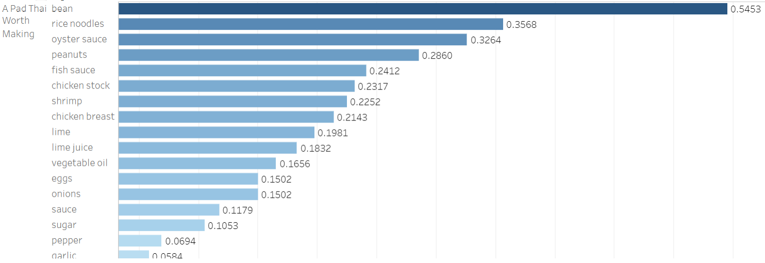
TF-IDF Results: Unique Ingredients in the recipe ‘A Pad Thai Worth Making’

Slide 13
Research Question 2
What is the alternative for a missing ingredient in a recipe?
Recipe recommender (Similar recipes based on recipe names) Jaccard Based on ingredient (tfidf & cosine)
Two passes:
1. Suggest related ingredient from BBC data
If not found:
2. Identify similar ingredients based on context within the recipe and its occurrence in our corpus.
Library: Gensim
Model: Word2Vec
Notes:
Dimensionality set to 300, Context Window set to 1 and down sampling parameter set to give less weight to common ingredients.
Explain
Risotto - arboreo rice
Term frequency?
Dimensionality? -- Reduce (trial & error) - same results? No difference in 1000 or 300 --- Read up!
Why is TFIDF a measure of importance? ---- Is it replaceable or not in a recipe!
Left – TFIDF Right – Look for an example(Chocolarte Chai Sherbet) or all american salad?

Slide 14
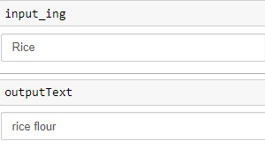
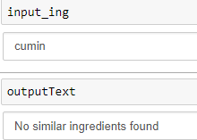
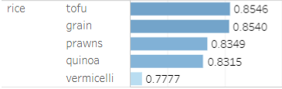
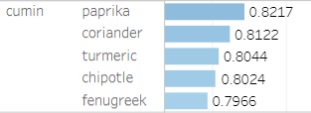
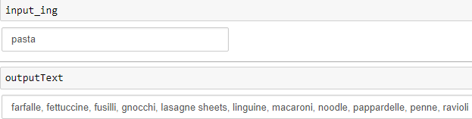
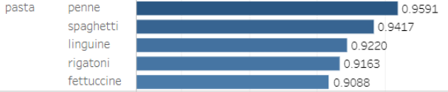
Ingredient Similarity Models
Recommendation for similar ingredients from BBC Food website
Recommendation for similar ingredients based on the word2vec model on Yummly
Notes:
Step 1 – BBC data

Slide 15
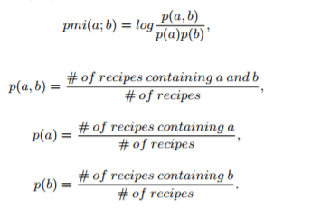
Research Question 3
What ingredients complement one another?
Suggest complementary ingredients for good flavour combinations.
Pointwise Mutual Information
Probability that two ingredients
occur together against the
probability that
they occur separately.
Notes:
The PMI gives the probability that two ingredients occur together against the probability that they occur separately.
Complementary ingredients tend to occur together far more often than would be expected by chance.

Slide 16
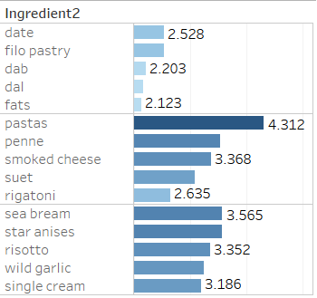
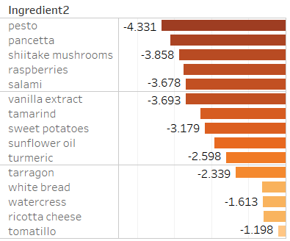
Complementary Ingredient Pairings
Ingredients that go well together
Ingredients that don't go well together
Cumin
Pasta
Rice

Slide 17
Research Question 4
Can we suggest similar recipes based on recipe names or ingredients?
Suggest based on recipe names Metric = Jaccard Similarity between Name strings
Suggest based on recipe ingredients
Metric = Cosine Similarity between TFIDF vector
Notes:
Insert Jaccard Similarity formula
Genism library similarities which provides a function called MatrixSimilarity to get cosine similarity between documents.

Slide 18
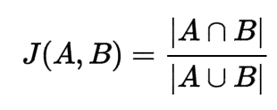
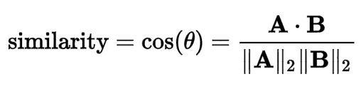
Recipe Similarity Models
Similarity based on Name of Recipe
Similarity based on Ingredients in Recipe
A = "Banana Split" B = "Banana Pie" J(A, B) = 0.33
A = "Banana Split American" B = "Banana Pie American" J(A, B) = 0.5
A = "Banana Split American" B = "Banana Pie Italian" J(A, B) = 0.25
Add Cuisine to Name to bias towards same cuisine
Works directly for user inputs : E.g. "Potato Mushroom"
Recipe | Cheese | Butter | Egg | Bread
Cheese Sandwich | 0.5 | 0.3 |  | 0.6
Omelette | 0.3 | 0.5 | 0.6
TFIDF + Cosine works well to recommend recipes from different cuisines
Works on vectorized user inputs
Notes:
Step 1 – BBC data

Slide 19
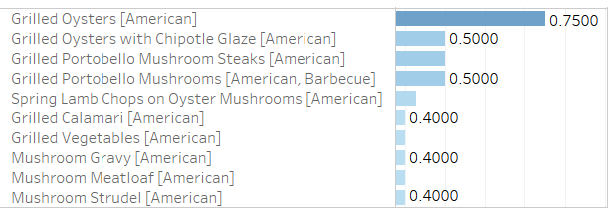
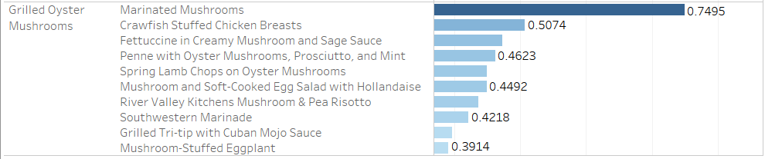
Recipe Models: Insights
Based on Recipe Name
Recipe Suggestions for "Grilled Oyster Mushrooms"
Based on Recipe Ingredients
Notes:
Which to use when?
Pros and cons?
Jaccard – will find close or really close (user inputs ---- autocomplete) --- Include interesting examples!
TFIDF – based on what's in ur fridge (limited to recipes in our database)

Slide 20
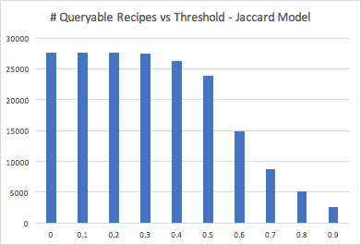
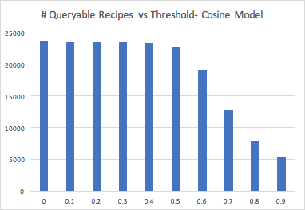

Validation: Recipe Suggestions
Name-Based Recommender Ingredient-Based Recommender
QUANTITY
Jaccard Similarity Threshold : 0.7 Cosine Similarity Threshold: 0.7
QUALITY
Random Sample: 60 Recipes
Random Sample: 50 Recipes
Accuracy: 69.9%
Accuracy: 68%
Sample (Threshold) :All 27637 Recipes Sample (Evaluation) : 50 Random Recipes
Notes:
68% percent
Histogram
Threshold
Why did we chose evaluation technique
Accuracy of Quality vs. quantity of reco.

Slide 21
Interesting Findings!
Data:
BBC food data listed pizza and cake as ingredients for recipes!
Alternate Ingredients:
Word2Vec predicted paprika as a substitute for cumin, while BBC Food didn’t have cumin
Word2Vec model mostly gives the similar ingredients, but for some it also gave complementary ingredients. E.g. Chocolate -> Berries, Banana
Recipe Recommendations:
Jaccard Model is useful for finding duplicate recipes or exact matches in database
TFIDF + Cosine Model does well to identify recipes based on similar ingredients
Notes:
BBC food data itself is not very comprehensive and reliable
68% percent
Histogram
Threshold
Why did we chose evaluation technique
Accuracy of Quality vs. quantity of reco.

Slide 22
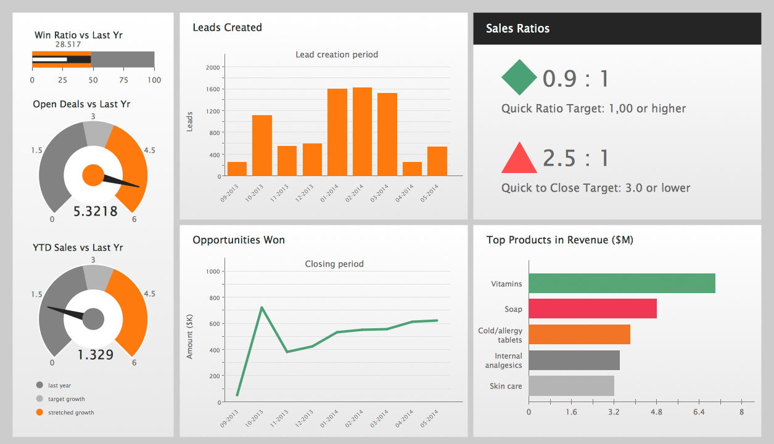


Final Data Products
BBC: Standardized Ingredient names
BBC: Related ingredients list
Similar recipes and ingredients models
Complimentary food index based on PMI scores
Complete food recommendation system based on Yummly data of 28k recipes and BBC Food Data
Live Dashboards for
Recipe Suggestions
Ingredient Suggestions
Complimentary food pairs

Slide 23
Limitations
Ingredients limited by BBC Data
Cuisines data – Not leveraged
Duplicate Recipes – Not leveraged
Recipe Name Cleaning:
Proper Nouns, Adjectives in Recipe names ("Stuart's Delicious Hamburgers")
Ingredient List Cleaning:
Using ingredient quantity – Not leveraged
Use rating of recipes
No Trigrams( "Bicarbonate of Soda", "Beef Braising Steak", "Spring Roll Wrappers")
Order of Ingredients in Recipe – Not leveraged (except in Word2Vec)
Notes:
Ingredient limited by BBC Data - Language considerations

Slide 24
Future Work
Scalable framework for data processing
Create a Flask API for similar ingredients predictions and similar recipe predictions
Network Analysis of Ingredients
Cuisine-Appropriate Recommendations for ingredients

Slide 25
Thank You

